Slide 1

Explore the new features of
5.70/00 + 5.70/01 CAM Plus, CAM smart

Slide 2
General:
  Windows 8.1 support
  Support of new Device variLEX 7xxx
  Photoshop connection plug-in now supports newest Photoshop CC 2014.
End of Life for Electronic 4000:
  Backplane for EL4000 machines (MAX 4xxx, bestLEN 511x, LEN4xxx)
  No ecoLEN with EL4000, No LEX 4xxx, No LEN 2000 or LEN 3000 machines.
CAM smart User interface (new):
  Modern UI style for CAM Smart
  Switching/Upgrading between Smart UI and Professional UI (CAM smart/CAM Plus) is now possible via licence.
  ATTENTION: Professional is standard UI which is not finger operation optimised!

Slide 3
CAM Output:
  New Modern style for CAM Expert on textile machines (endless devices).
  Continuation of Legacy CAM UI till end of 5.70, but not in any further release.
  ecoLEN 731X, bestLEN 741X
  Below surface engraving of file content
  Display of job output time without starting it
  Automatic Job Archiving after done.
  Pending list improvements
  New Policies for Job and pending list handling
  Job Editor:
    New file alignment features for creating smart templates (Left aligned, Right aligned, Center)
    Files within smart templates can now locked.
    (file path are stored with the template like for complete jobs

Slide 4
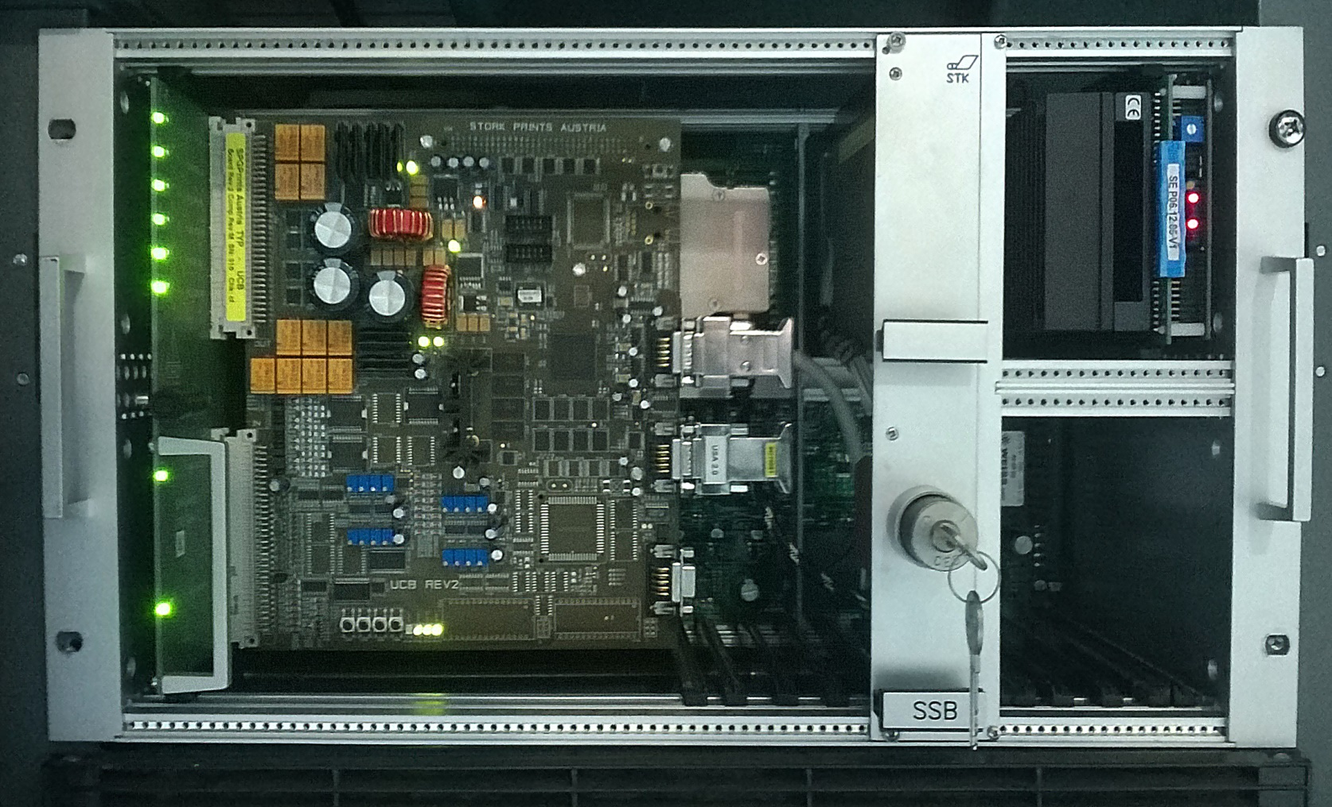
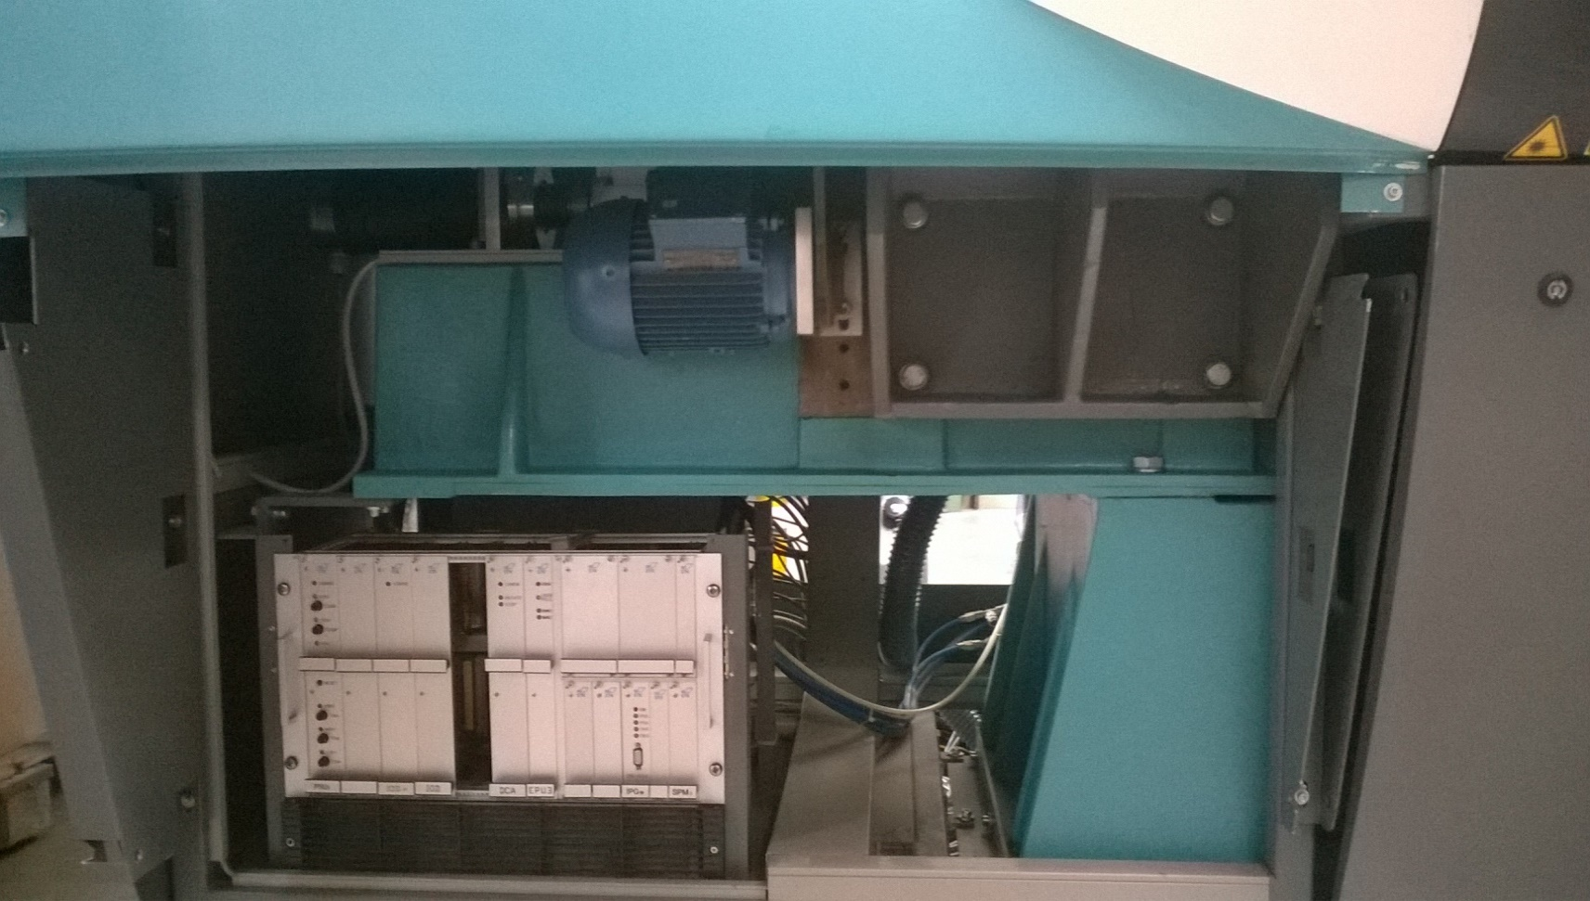
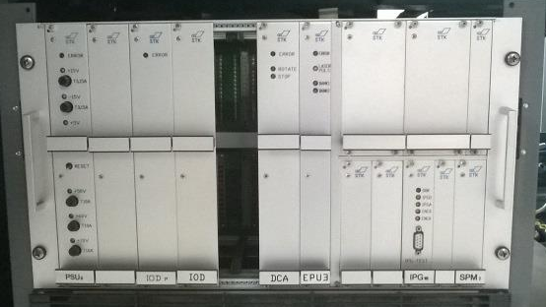
EL 4000 discontinued!
New backplane adapater
for UCB

Slide 5
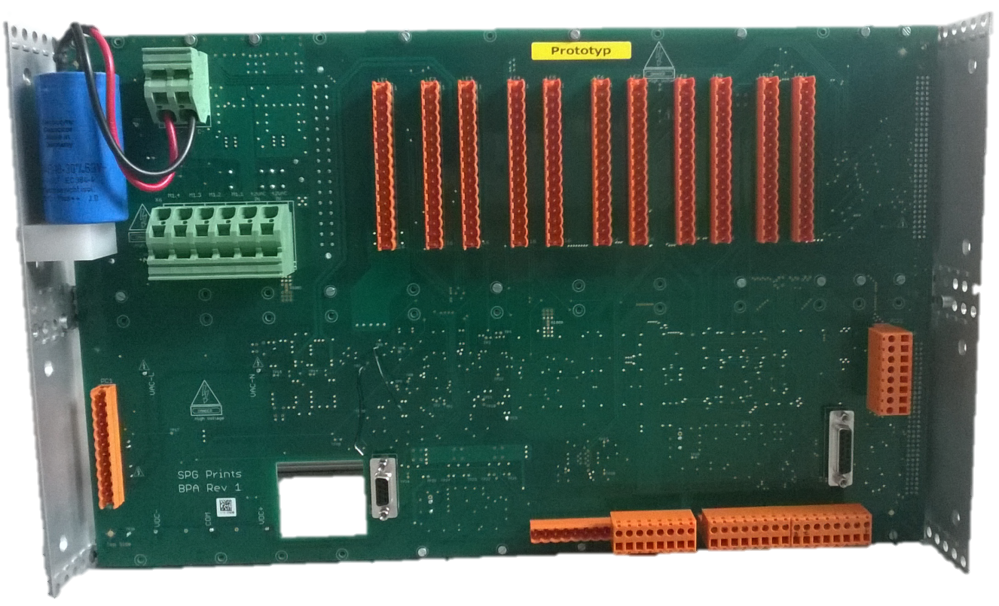
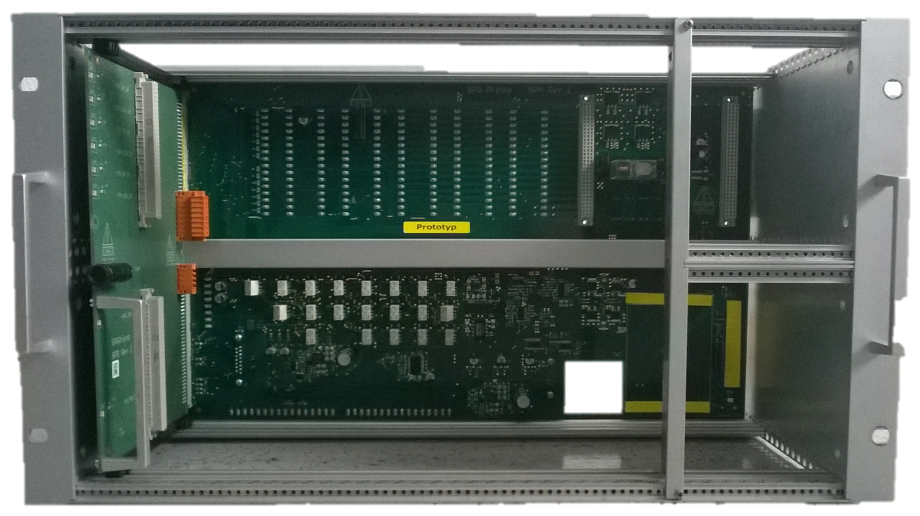
Back side compatible to legacy machines
Front side compatible to UCB
UCB firmware supports now all legacy features like tension roller, end ring system, focus lens motor, legacy DC Z-Axis and of course MAX head with 256 nozzels.

Slide 6
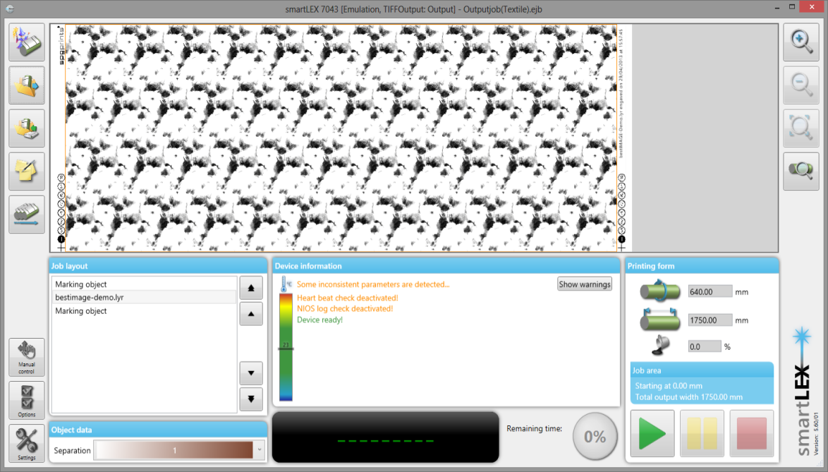
CAM smart and the way to CAM Expert
CAM smart was an introduction of an simplified UI. It was designed for 16:9 widescreen monitors only and its positive feedback is limited. It’s focus was making engraving easier. This was achieved mainly by the job wizard and due to reduction of the GUI. The problem is it still looks quite over-powered. If we convert it now to CAM Expert with all options needed, it ends up in ragbag overloaded with effects and colour.

Slide 7
Modern UI Style (Metro style)
The Concept
Clear typography interface (only established icons)
Less colour on menu and programs
Focus to content (use colour here)
The Opportunity
Reduced screen requirements
(possible to use very small sizes)
1 User interface/experience
for Smart and Expert mode
The Potential
Increased customer satisfaction due to
simple HMI

Slide 8
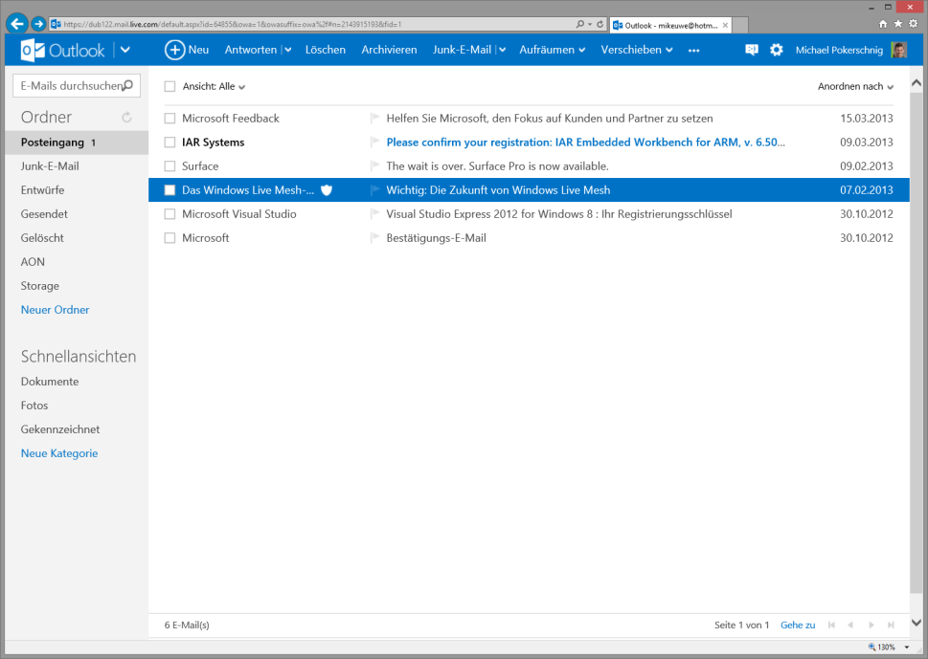
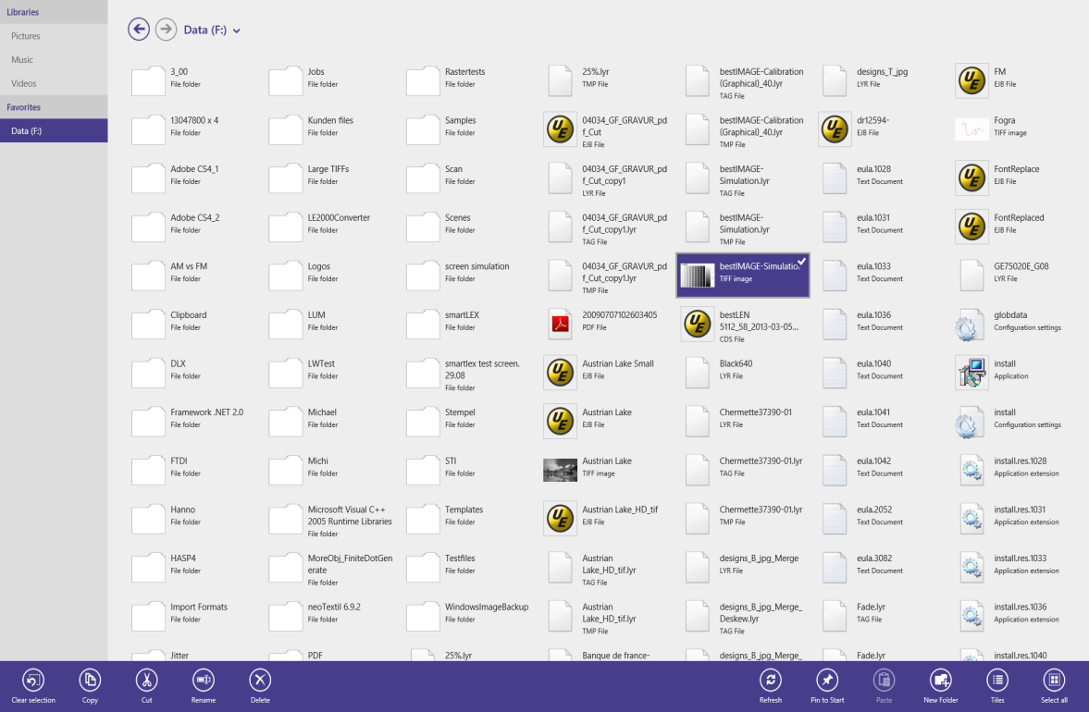
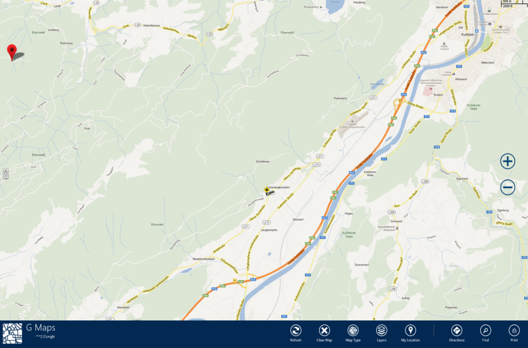
Modern UI style examples
Focus on content
Reduce/hide options not needed yet
1 plane not several windows stacked onto each other

Slide 9
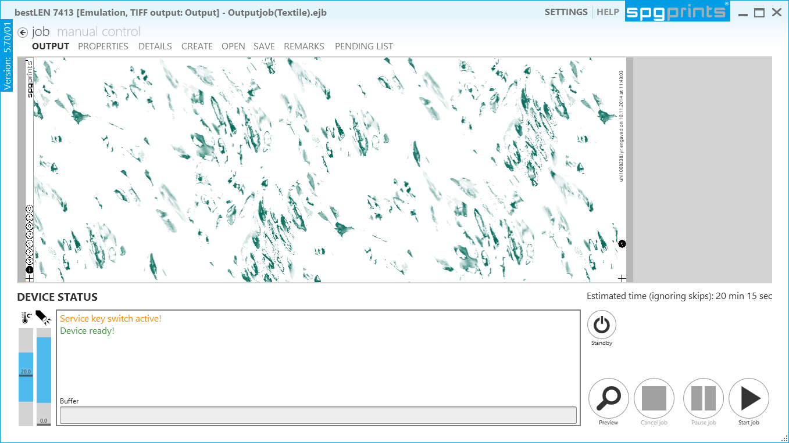
Modern UI style for CAM smart/expert

Slide 10
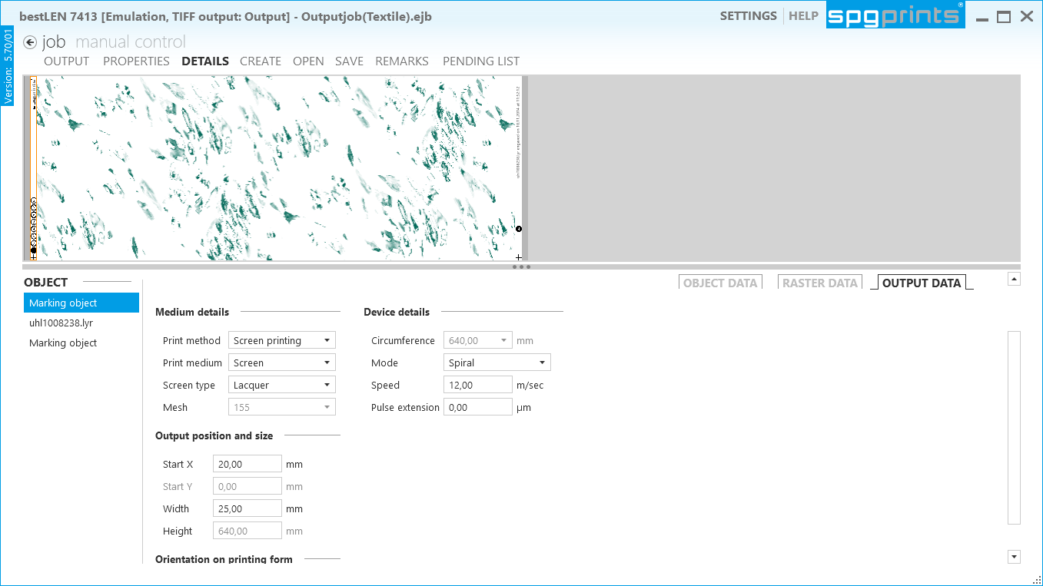
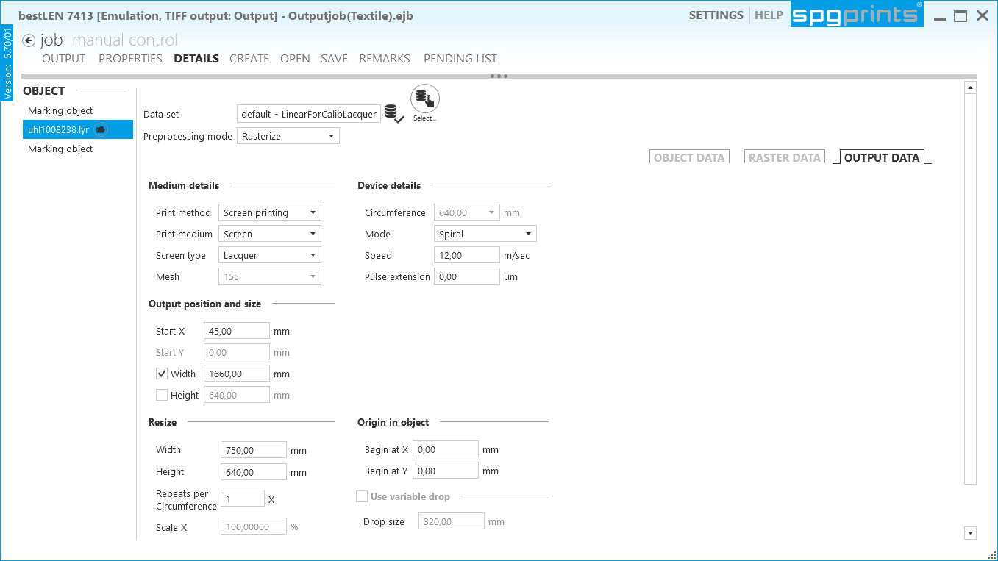
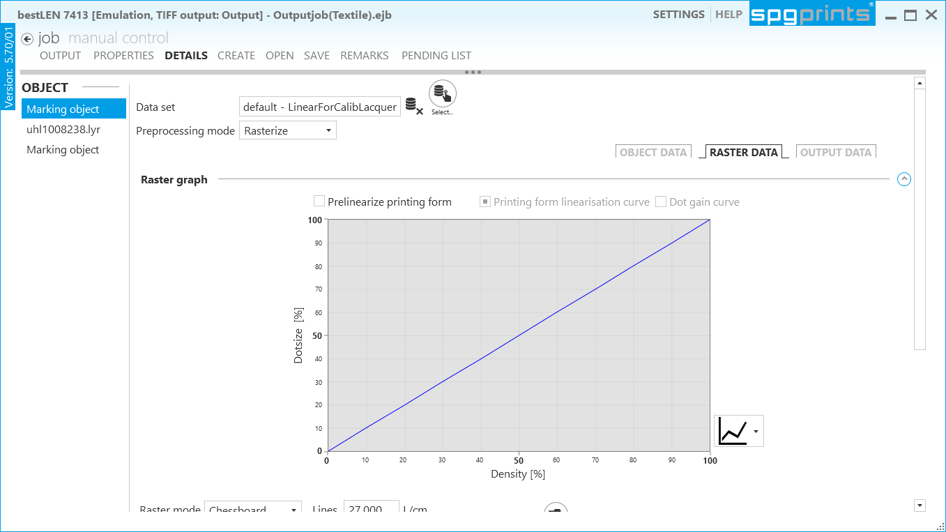
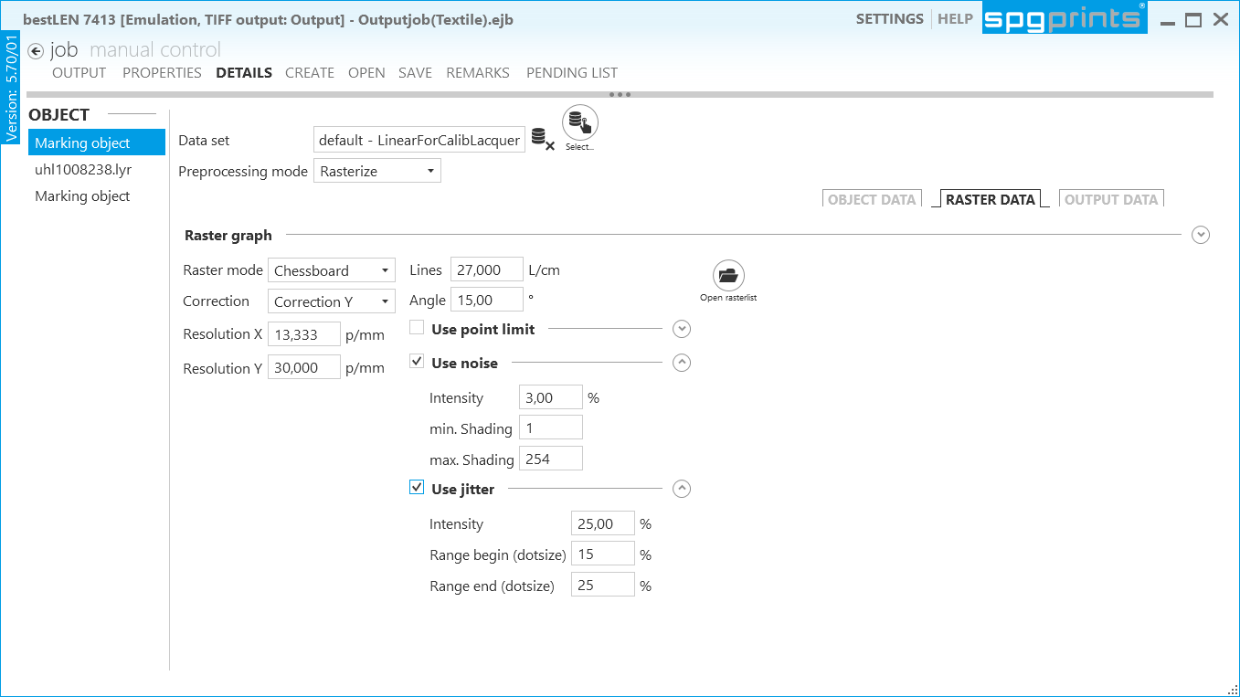
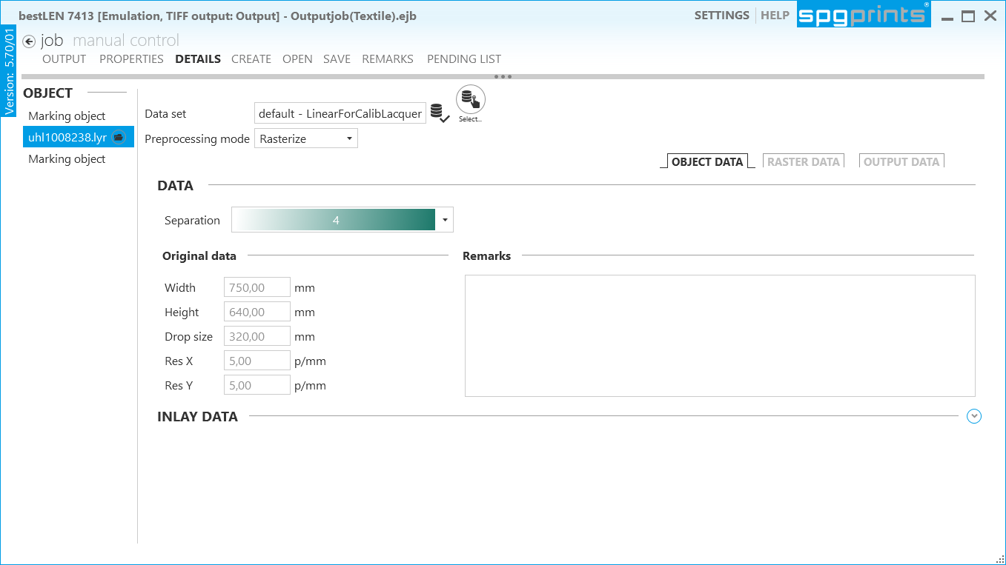
Where are the parameter details of expert mode…

Slide 11
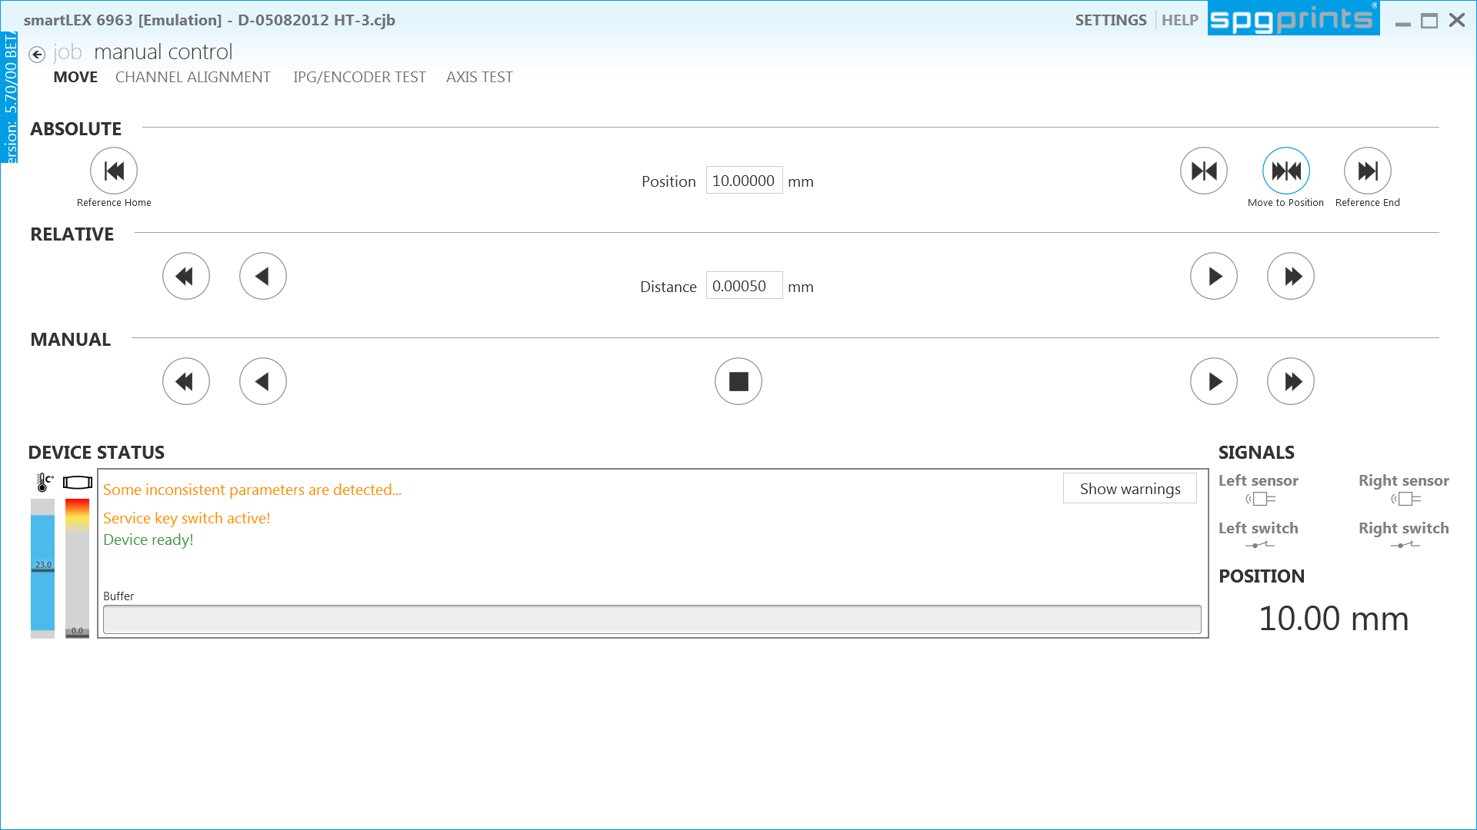
Job output or manual ctrl

Slide 12
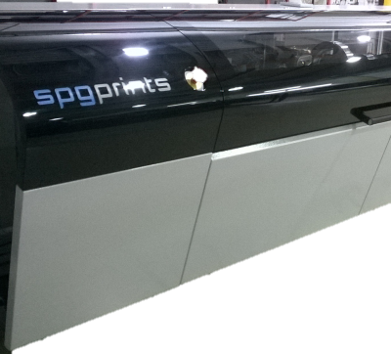
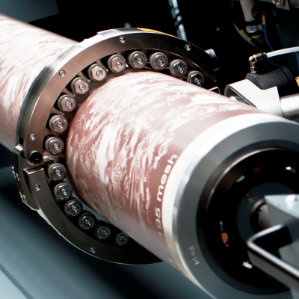
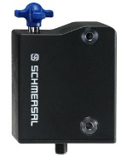
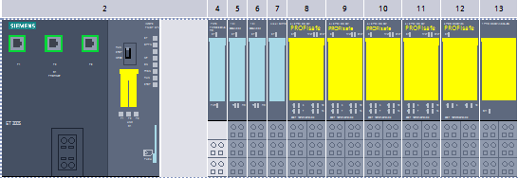
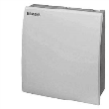

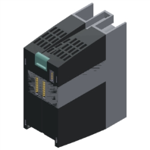
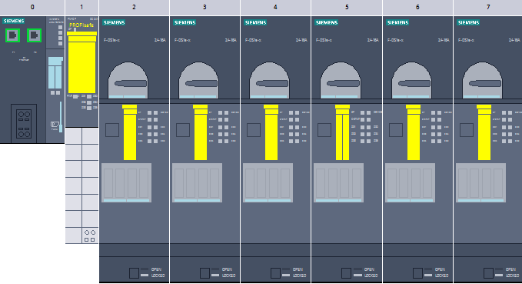
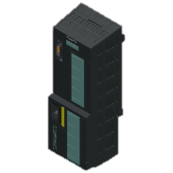
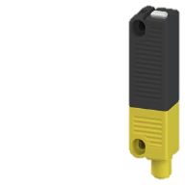
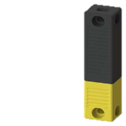
Support for new machines ecoLEN 731X, bestLEN 741X
  New design with touch enabled monitor (but also keyboard and mouse)
  Permanent regulated laser (not for ecoLEN 731x)
  Motorized Z-Axis
  New laser type J-Series with more logging data (Voltages, Temps, VSWR, Reflected power)
  Screen support ring system
  New AOM driver with logging data (VSWR)
  Safety related components all realized in Performance Level E
  (according to EN ISO 13849 standard specification)
  Safety cover errors now with numbers
Environment
Temp+Humidity logged
Rotation drive
controller
with SS1+STO
Ple
Back cover sensors
PLe Emergency Stop
PLe
Cover lock
PLe Safety controller
with profinet

Slide 13
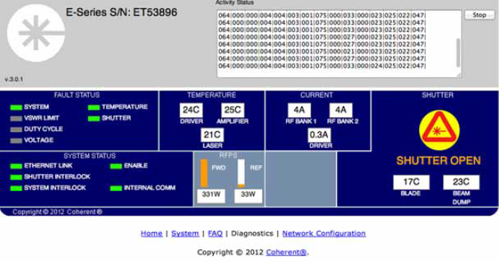
New laser (ecoLEN 731X, bestLEN 741X) with web page
http://serial_number/

Slide 14
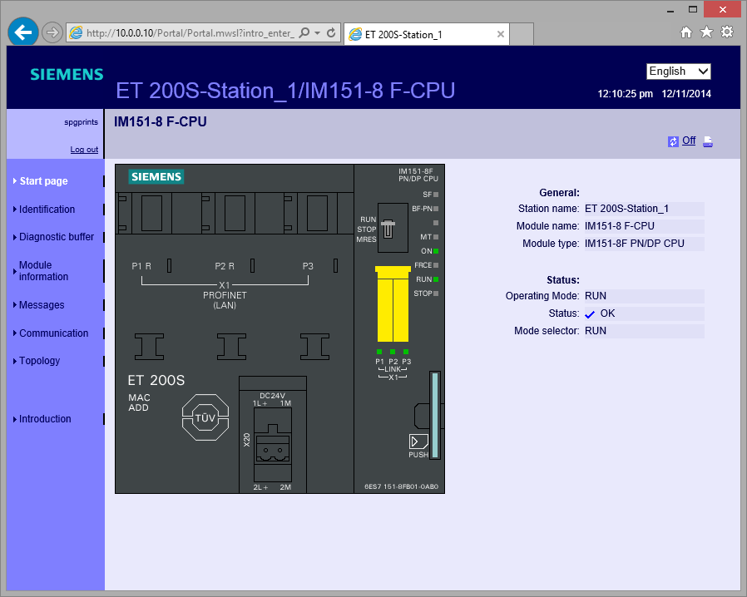
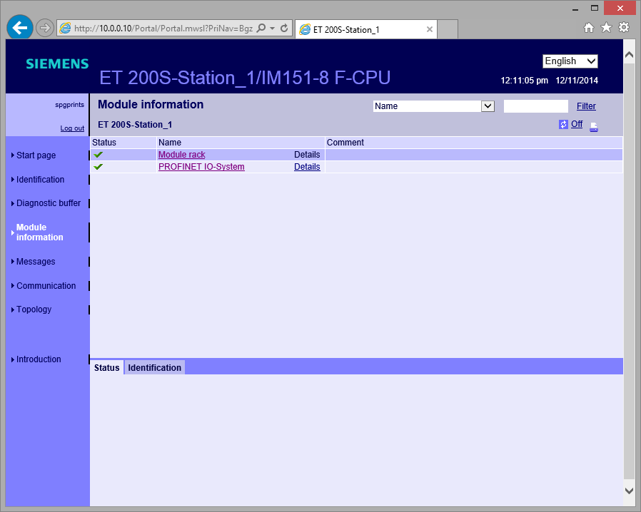
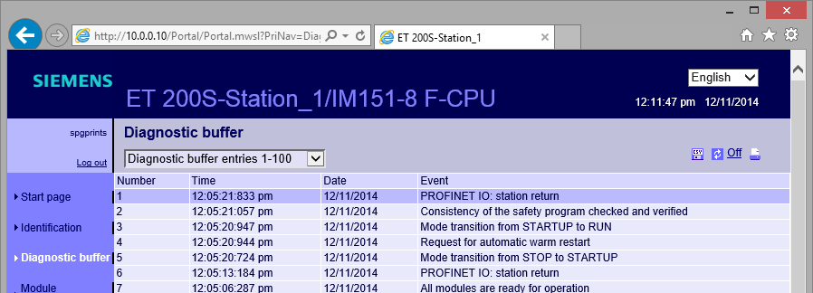
New Safety controller (ecoLEN 731X, bestLEN 741X) with web page http://10.0.0.10

Slide 15
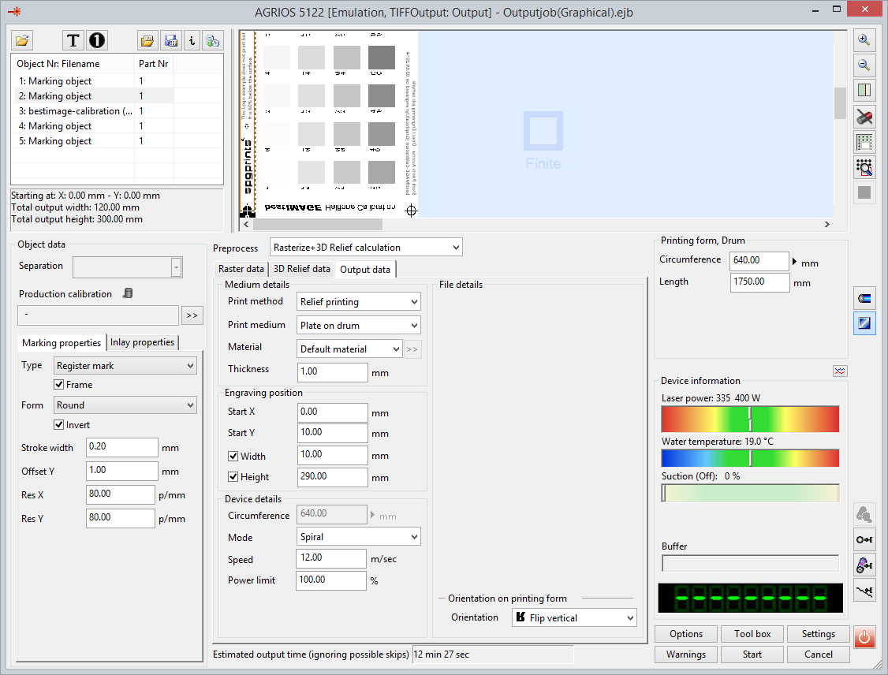
  Output time of job is now already pre-calculated when job is loaded and without errors (start button active).

Slide 16
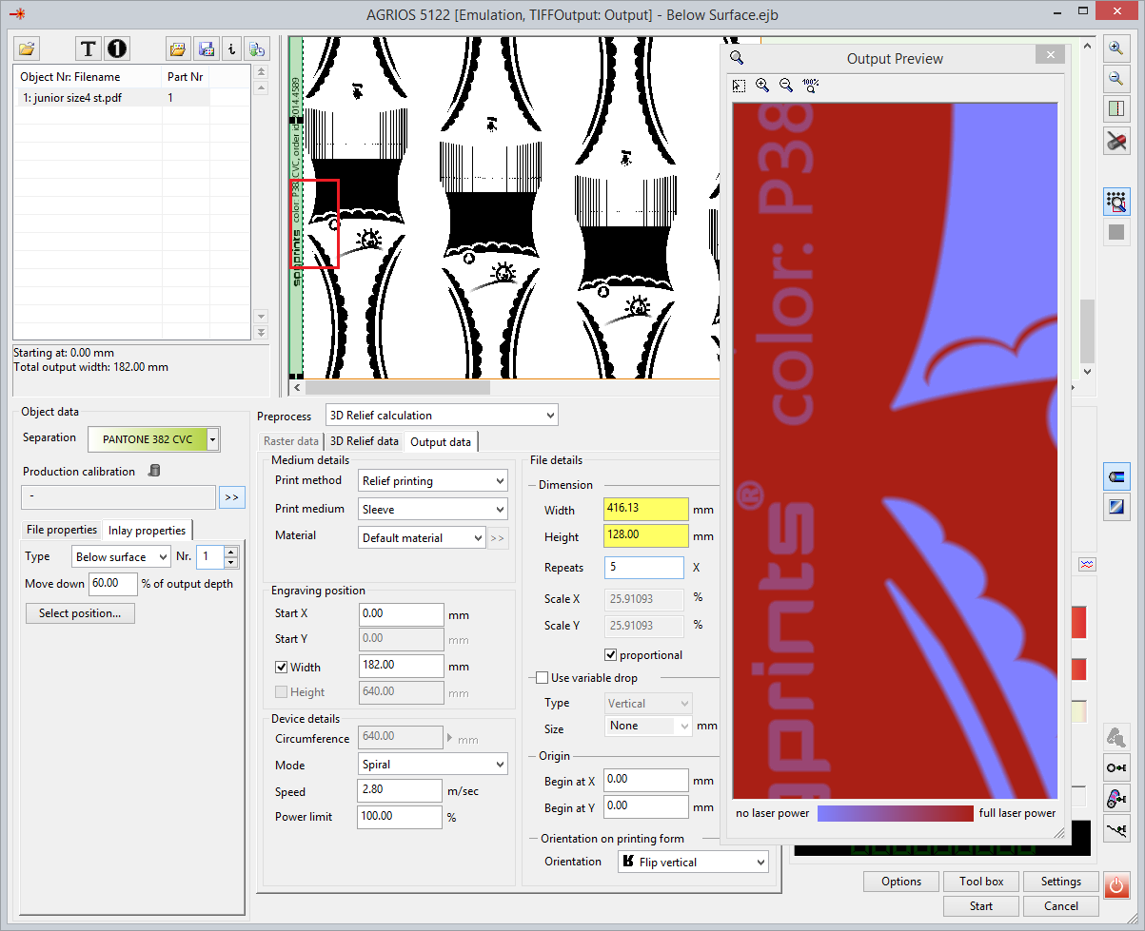
60% below the surface!
  For DLE machines:
  With new Inlay-Object you can engrave any region inside a file a user definable % under the surface to make it not printable.
  This can be used for none printable
  information on sleeves/plates that
  is not available as text macro (for example the Order-ID), but is already present in the file.

Slide 17
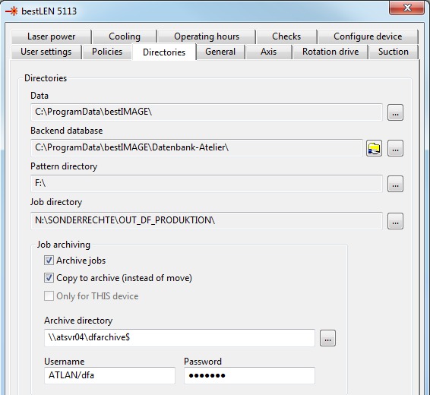
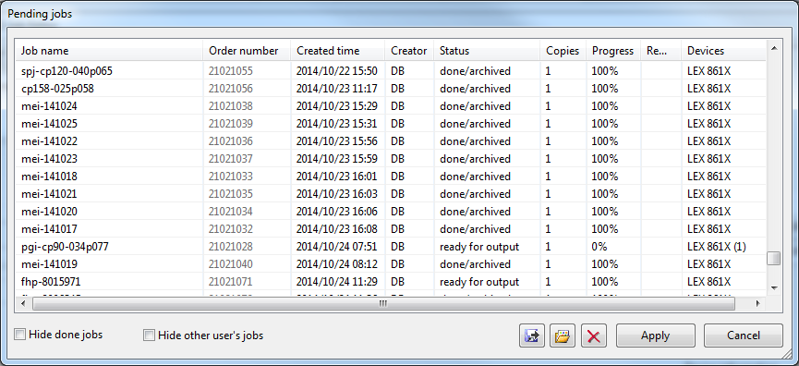
  Automatic Job-Archiving after it`s done:
  Listed jobs in the “Pending list” are automatically archived to the defined Archive server in the Settings.
  Archived Jobs get the state done/archived and stay available for repeat order.
  Archive tree structure is
  <YYYY.MM.DD>/<Order#>/<Job files> (if order number is present)
  <YYYY.MM.DD>/<HHMMSS>/<Job files>
  For the archive location the system uses a dedicated archive account with a password. This prevents users to modify the archive manually.

Slide 18
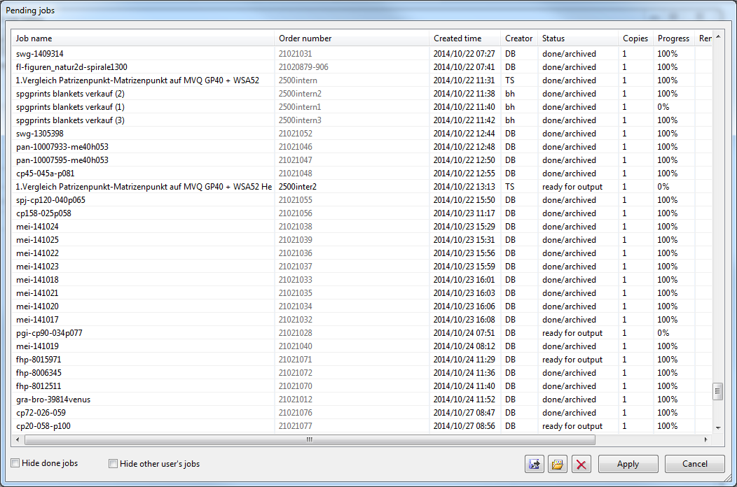
Pending list improvements
  Order numbers, can be assigned to jobs in pending list.
  Apply no more closes the list, multiple operations therefore possible.
  New status “Aborted” to indicates if job was not successfully finished. You get reminded by CAM software automatically about aborted jobs and its possible to restart them.
  Copies, can be assigned to jobs in pending list to indicate you want this job to be done several times.

Slide 19
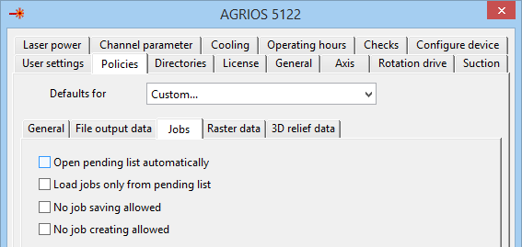
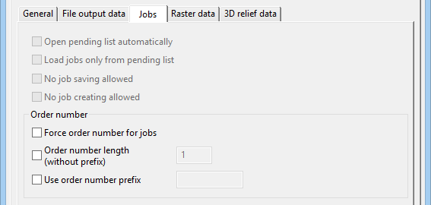
New Policies for Job and pending list handling
  Load jobs only from pending list, prevents operator
  from opening jobs which are not spooled to pending list.
  No job saving allowed, disallows saving of jobs by the operator.
  Operator just can load, output and if working with a pending list jobs may
  be archived automatically.
  No job creating allowed, disallows creating of jobs by the operator.
  Neither wizard based nor manual job building via objects/files.
  Operator just can load, output and if working with a pending list jobs may
  be archived automatically.
  Force order number of pending list, number must be specified when
  status is set to ready for output.
  Use order number prefix, can be used to pre define fix starting
  order number characters like “200-” for “200-9912848”.
Job editor:

Slide 20
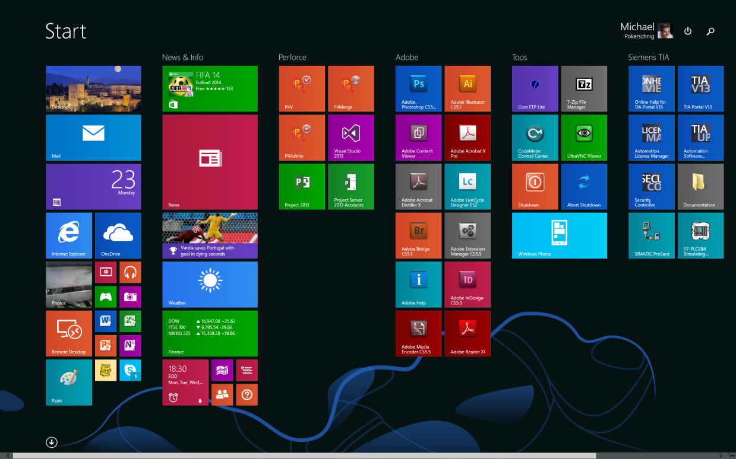
Windows 8.1 (standard machine OS at bestIMAGE 5.70)
The corners are the trick!
No start button (well at least not like under Win7)
But Tiles to jump to apps
Shutdown/Logoff button
is found in in charms/settings and
on top of tiles view
Live ID not needed
Settings on Charms menu
+ right corners (or Win+C)
or on context menu of start button
Switch task on left upper corner
Desktop tile to jump to desktop

Slide 21
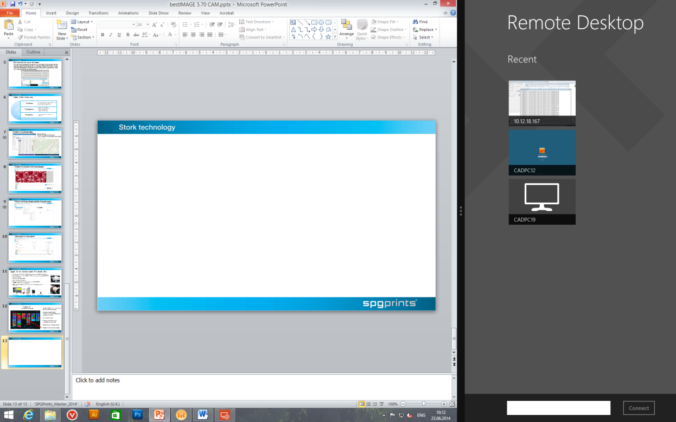
Splitting the monitor with Apps but not with several desktop application. Complete Desktop is like 1 App.

Slide 22
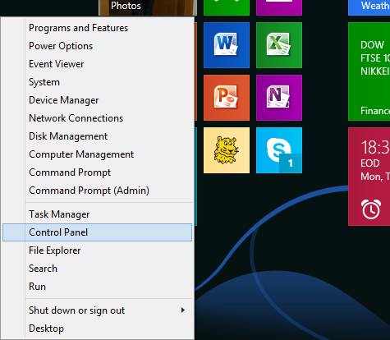

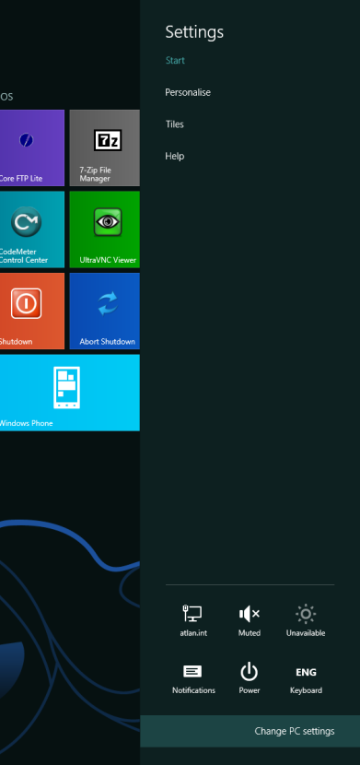
For administrative tools click with right mouse button at lower left corner or use Charms-Menu and goto Settings

Slide 23
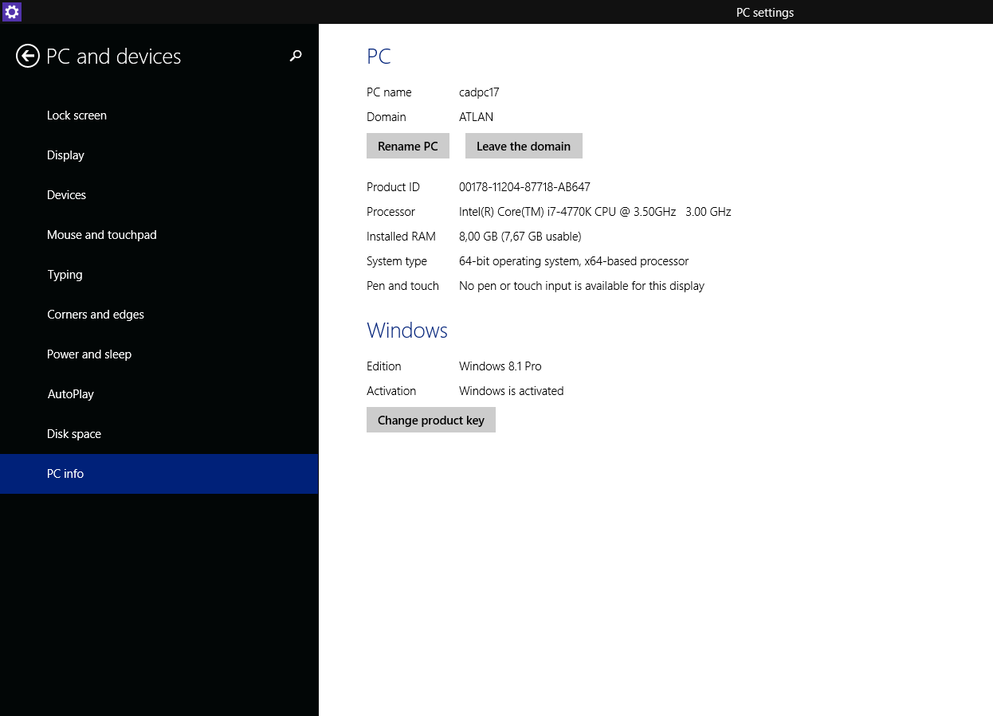
The PC settings App also provides access to most settings of PC
But does not completely replace the control panel (not yet at least)
The settings menu (as seen in page before) can be specific to an app but not to desktop applications as all desktop applications run inside desktop which is 1 app.

Slide 24

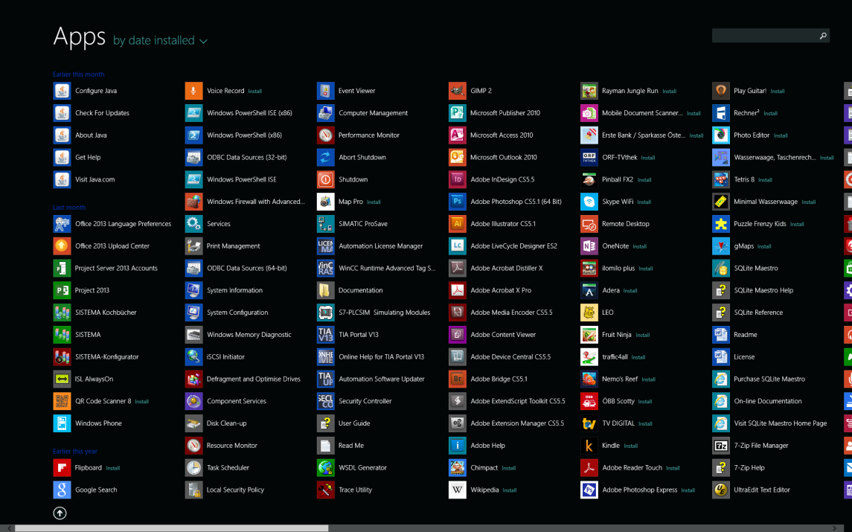
For complete list of applications click on arrow or use search button of charms menu or search button on tile view (win 8.1 only)
Select apps and press on “pin to start” or “pin to taskbar” if you need a shortcut to it.

Slide 25
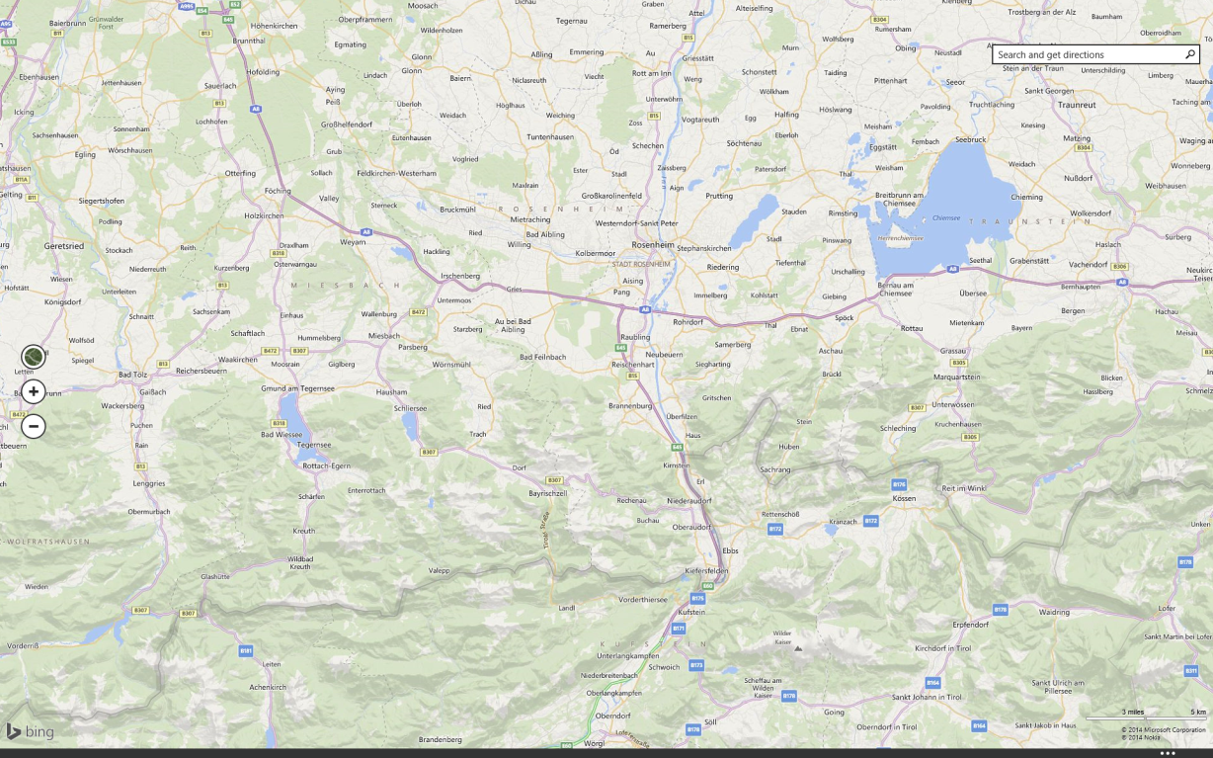
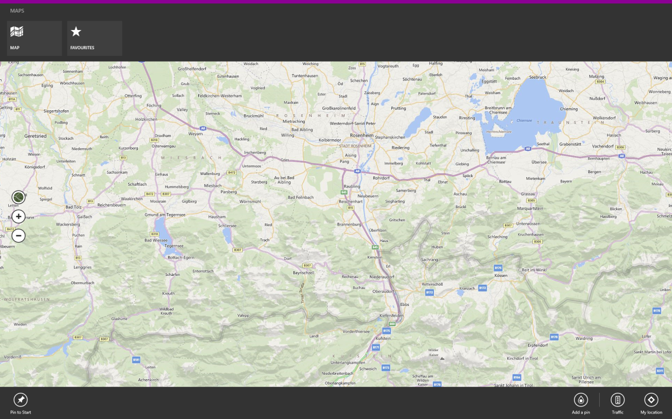
Right mouse click or swipe from bottom to top with finger opens menu bands in apps
To close an app swipe with finger or mouse from top to bottom. To change between apps swipe into area from left side or move mouse to left top corner.
(Windows 8.1 also provides the red X on a title bar if you move mouse to top.)

Slide 26
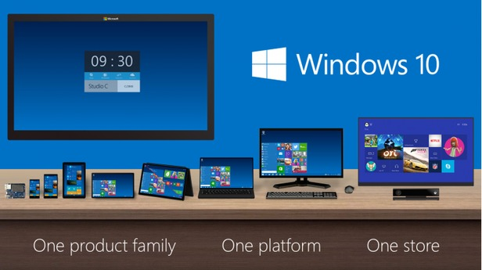
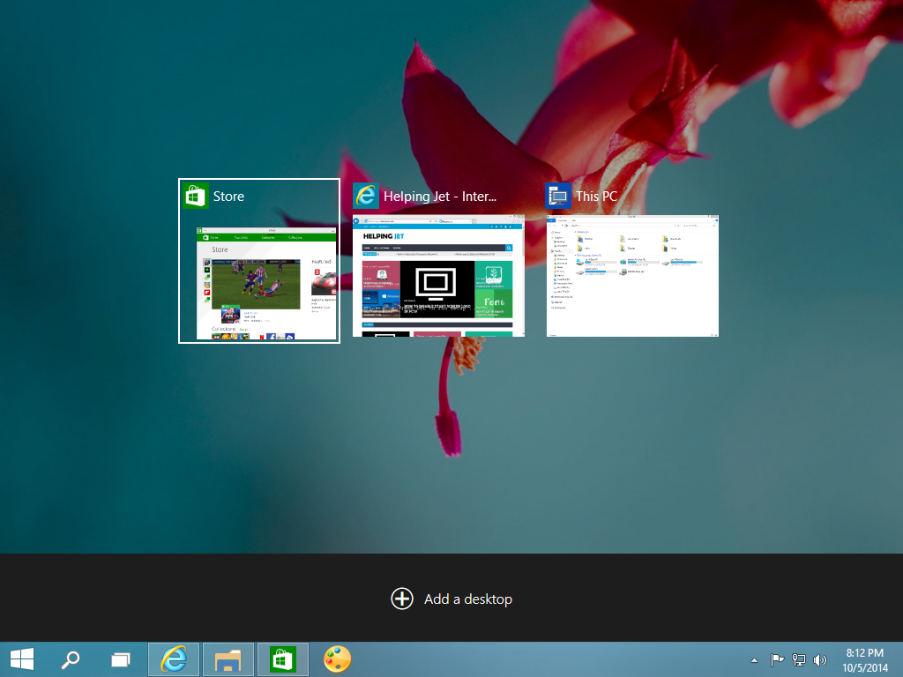
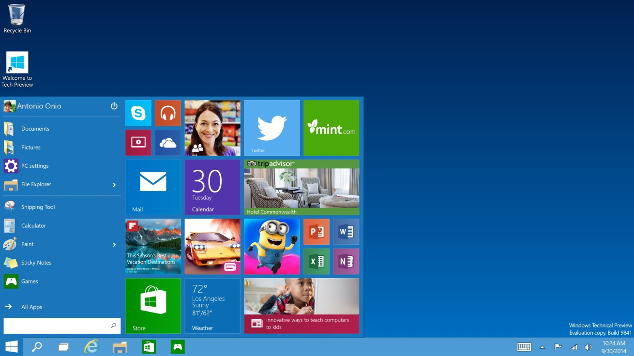
Play with it to get used to it…
Windows 10 will not remove tiles only maybe adding a smaller start tile section like the legacy start menu of Windows 7

Slide 27

© 2014 by SPGPrints Austria GmbH. Permission to copy without fee all or part of this material is granted provided that the copies are not made or distributed for direct commercial advantage and the SPGPrints Austria copyright notice appears. If the majority of the document is copied or redistributed, it must be distributed verbatim, without repagination or reformatting. To copy otherwise requires specific permission from SPGPrints Austria GmbH.
SPGPrints Austria may make changes to specifications and product descriptions at any time, without notice.

